Slide 1
Technical Governance Proposed Changes

Slide 2
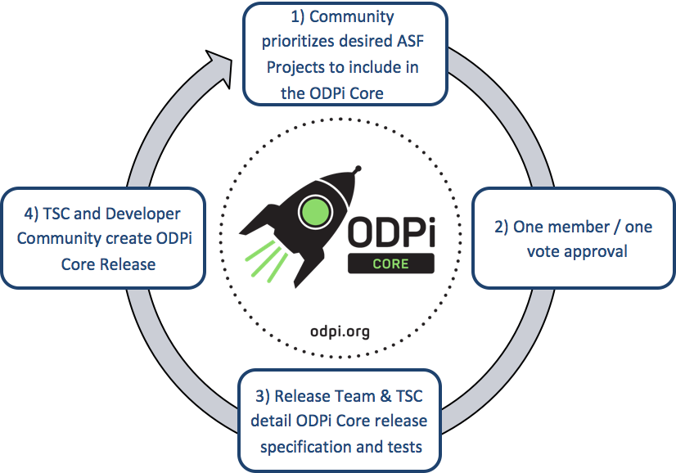
Motivations
ODPi has shifted from solely defining the contents of a canonical Hadoop distribution to being a hub for Big Data related projects
The entire technical governance structure was designed in mind with approving the addition/removal of components and defining compliance standards
With the addition of the Data Governance PMC, community deliverables are more varied

Slide 3
Guiding principles
TSC’s role is stewardship of open source projects in the Big Data space with a diverse set of constituents
Developers, Practioniers, End-users, Consultants, etc.
There is a defined process for projects to become sponsored by ODPi.
Each sponsored, mature project has representation on the TSC

Slide 4
TSC project inclusion process and stage requirements
Incubating
Active
Emeritus
Proposal made by a member company
TSC to review and approve
Project to provide monthly reports on progress
Project has delivered an initial release
Project has 5 contributors representing at least 3 different organizations
TSC to review and approved with super-majority vote
Project has a voting seat on the TSC, and must submit written status report for each meeting.
Project either decides on it's own that they no longer wish to continue development, or the TSC determines their is insufficient technical community support for actively maintaining
TSC to review and approve by super-majority vote
TSC commits to host any project assets indefinitely, but will not do any further releases or updates with the exception of addressing any security vulnerabilities or concerns.
TSC to assign mentor to project

Slide 5
TSC structure
TSC Chairperson
Incubation Lead
Emeritus Lead
At Large Member
At Large Member
At Large Member
Project Lead
Project Lead
Elected from ODPi Community at Large
One seat per Active Project
ODPi Community elects up to 5 individuals
Must confirm to diversity requirements
TODO – set nomination criteria
Each Active Project appoints a lead to serve on the TSC
TSC elects a Chairperson, Incubation Lead, and Emeritus Lead on a yearly basis.

Slide 6
Mapping of current PMCs and SIGs to new structure
Incubating
BI and AI SIG
Active
Runtime PMC
Data Governance PMC
Emeritus
Operations PMC
Spark and Fast Data Analytics SIG

Slide 7
Project Proposal outline
Name of project (must be unique within ODPi)
Project description (what it does, why it is valuable, origin and history)
Statement on alignment with ODPi charter mission
Sponsor from TSC (sponsor helps mentor projects)
License and contribution guidelines
Source control (GitHub by default)
External dependencies (including licenses)
Initial committers (how long working on project)
Infrastructure requests (CI / Cluster)
Communication channels (slack, irc, mailing lists)
Issue tracker (GitHub by default)
Website
Release methodology and mechanics
Social media accounts
Community size and any existing sponsorship

